Slide 1


SOLANA AGENT KERNEL
Ship agents that can't be used against you.
PRE-SIGN KILL SWITCH SAME SLOT REFLEXES ZK COMPRESSION

Slide 2

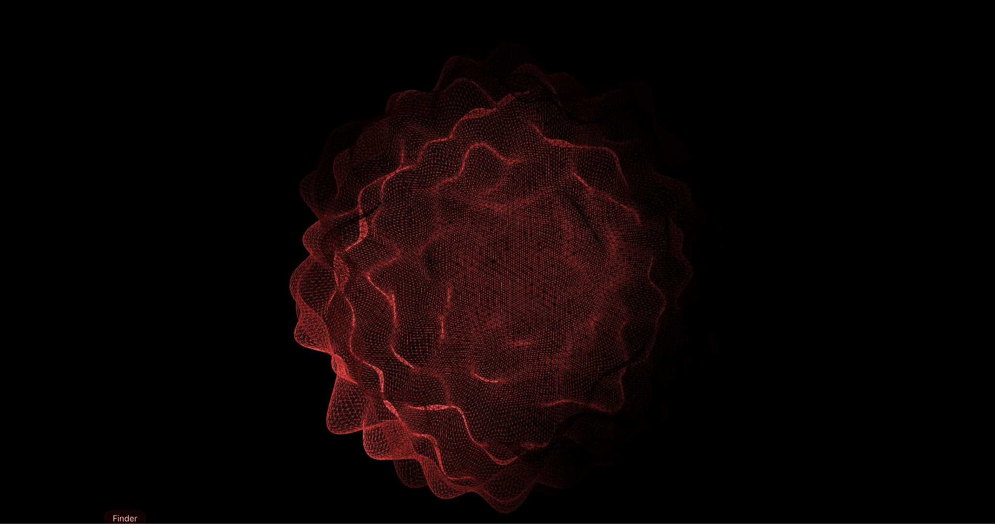
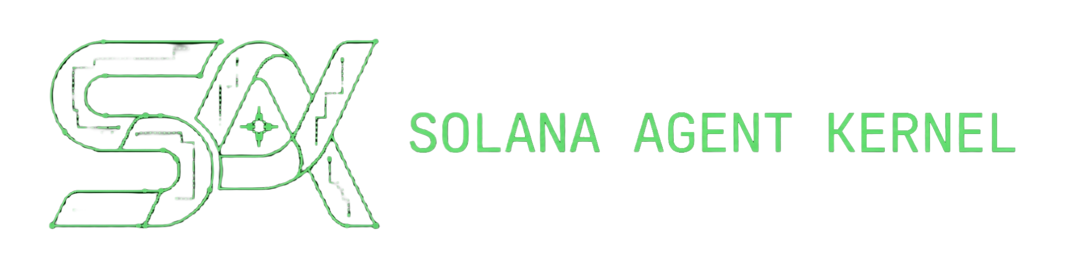
IF IT HAPPENED TO ME!!!
YOU COULD ALSO BE THE NEXT VICTIM.
EVERYTHING LOST. UNANSWERED.
DRAINED. DISCONNECTED. TOTAL SILENCE.

Slide 3
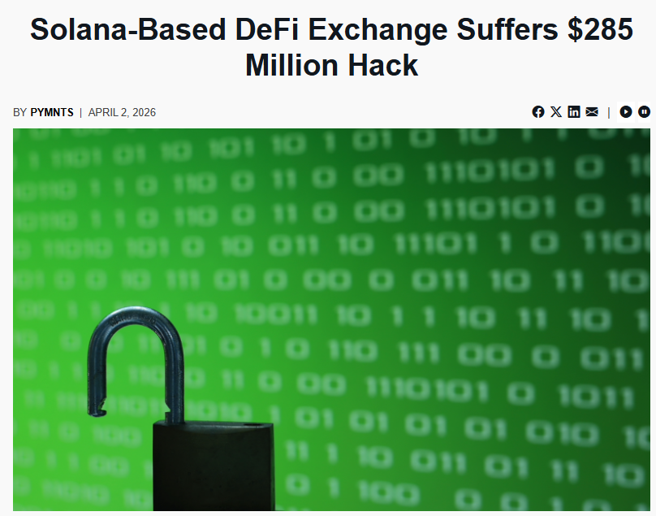
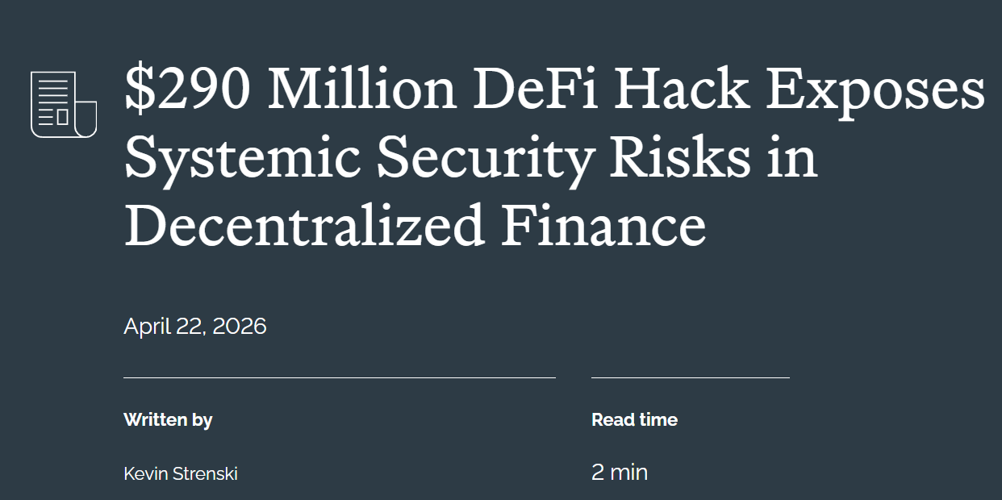
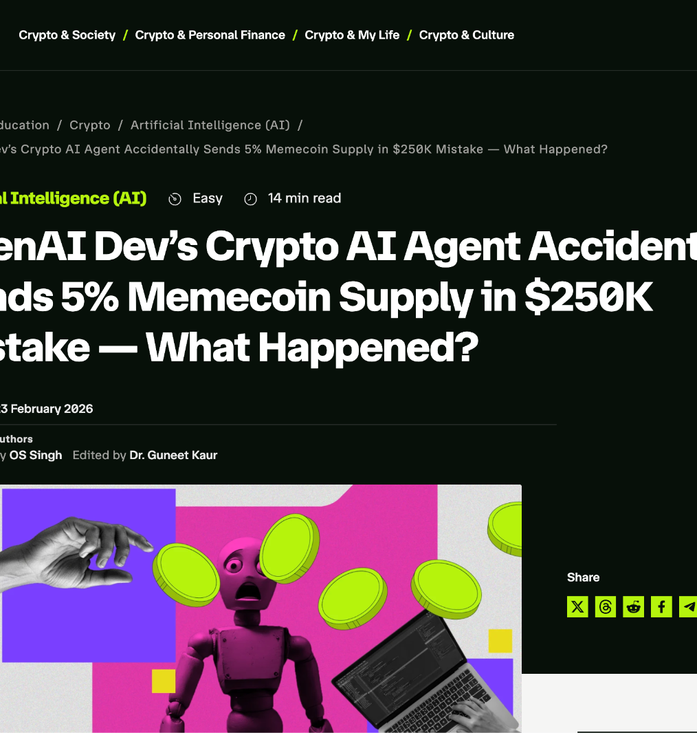
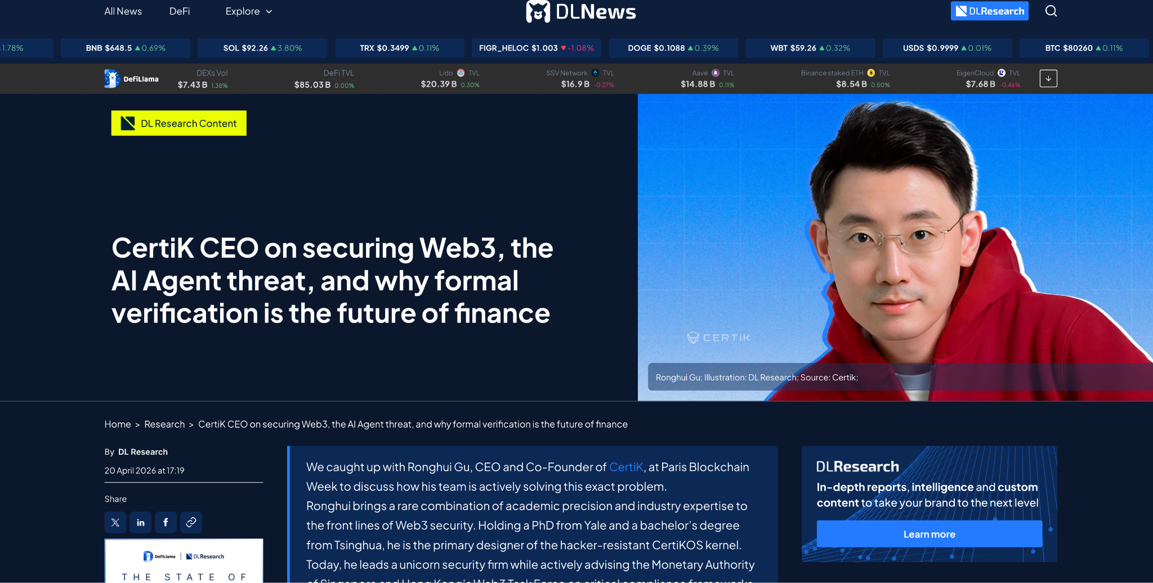
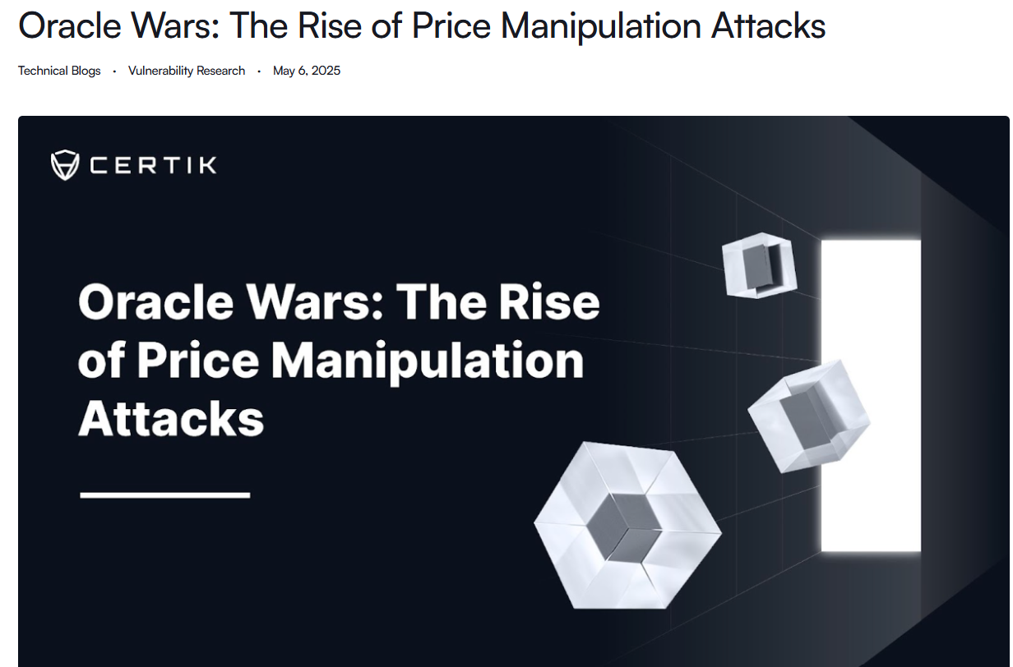
THE PROBLEM
$1.8B LOST
In 2025, LLM-linked crypto exploits reached a breaking point. AI agents are inherently prone to hallucinations:
99% Slippage Hallucinations
Malicious Account Drains
Unauthorized Program Invocations
Blockchain is final. There is no undo. Until SAK-1.

Slide 4
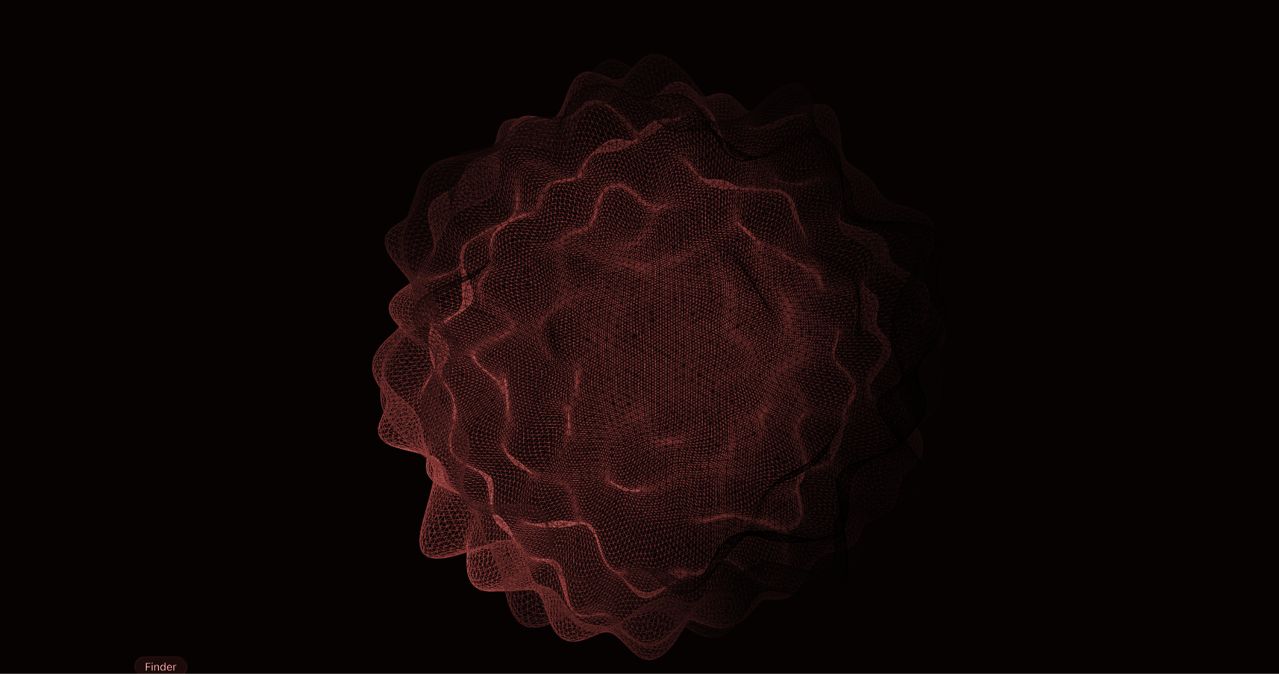
THE $1.8 BILLION GAP
llms tend-> to hallucinate. wallets are being drained.
& there is no “UNDO” button in the BLOCKCHAIN!!!!!

Slide 5
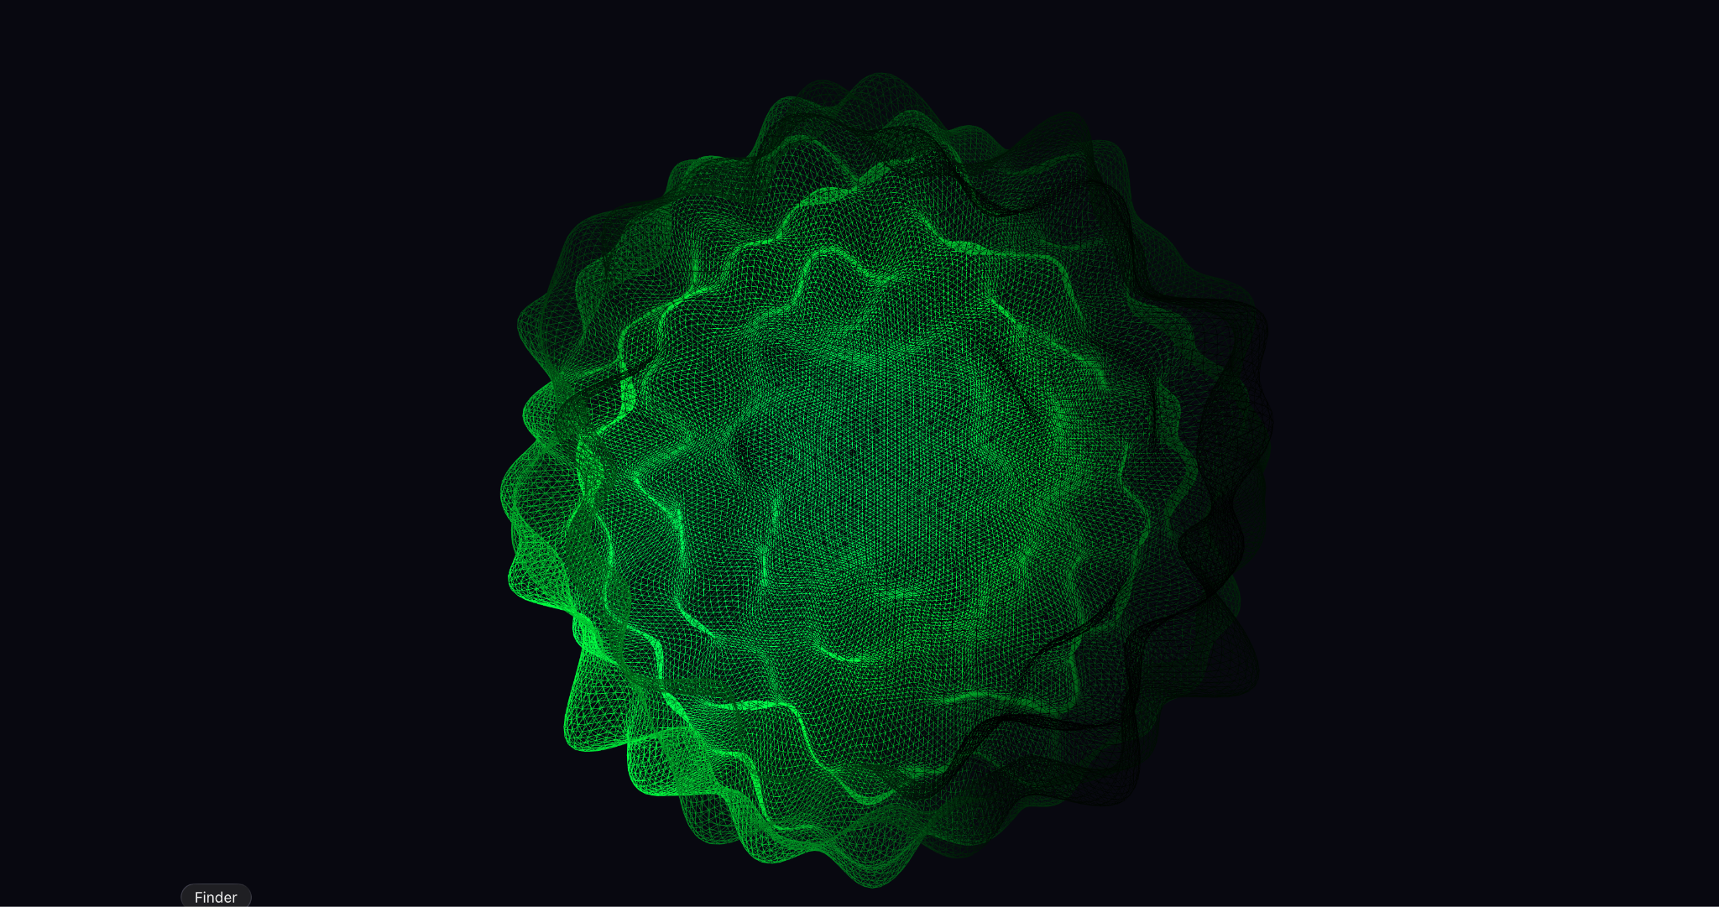






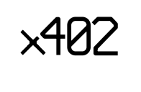




WHY NOW?
SOLANA AI ECOSYSTEM
THE PROBABILISTIC TRAP
BIG TECH STANDARD
$31B+
“Evals”
Agent linked volume across 2025
65% Failure
~49%
90% -> 10 step Defi strategy
0.90^10 = 0.348 Success rate
Stripe Minions
AI Micropayments made by Solana
State: Running Wild
State: Harnessed
Notes:
Why build this now? Solana is fortinor in AI micropayments , which as captured nearly 49% markets share today , 2025 alone 31 billions dollars volume made payments. Karpathy's 'March of Nines' math proves that If an agent executes 10 reasoning steps at 90% reliability, compounding dictates a 65% failure rate. To handle to tell companies like openAI and stripe built their own evals to make make their agents better reliably.

Slide 6

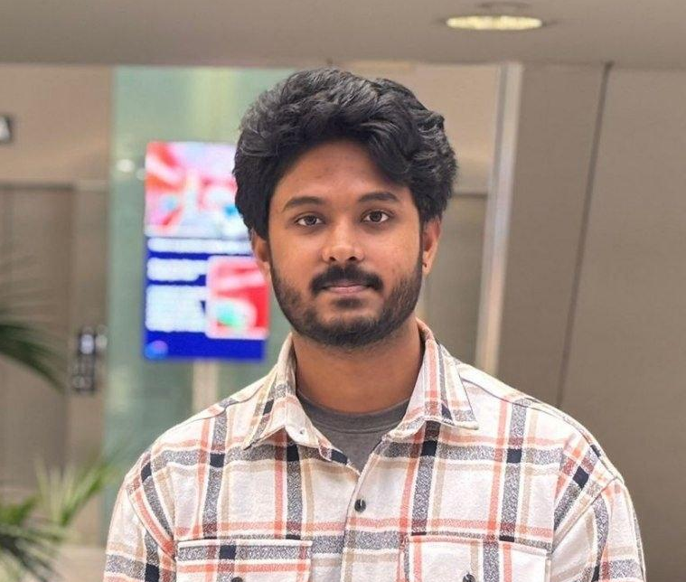







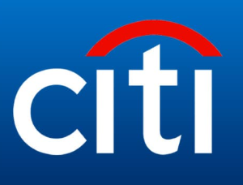




MEET THE TEAM
FOUNDER, CEO
CO-FOUNDER, CPFMO
CTO
Balaji Segu Krishnaiah
MSc in Artificial Intelligence
2026
𑇐 DeFi Protocols
𑇐 Smart Contracts 𑇐 LLM Models.
Sai Shreyas Gubbi Harish
MSc in Cloud Computing
2026
𑇐 Web3 & Compliance
𑇐 Enterprise 𑇐 Blockchain
Tejas Shiva Kumar
MSc in Data Analytics
2026
𑇐 Solana Dev 𑇐 Infrastructure
𑇐 AI Agents
TEAM ACHIEVEMENTS
Give(a)Go
2025 PROJECT:
$3,000 $500 $200
$500 Ongoing Ongoing
Notes:
We are the same team who won Hack europe solana track ,AWS global Agent Hackathon and many. Also building defi solutions with uniswap Hook incubator. We are masters students pursuing in AI and cloud from DCU and NCI. Who have been built web3 solutions and scalable infra.

Slide 7









FILLING THE GAP
BUILT FOR SOLANA
OFF-CHAIN (LOCAL MACHINE)
ON-CHAIN (DEVNET)
3. SOLANA NETWORK
1. LLM AGENT
Only receives transactions that have passed the SAK simulation.
2. SAK KERNEL
THE DETERMINISTIC RUNTIME FOR AUTONOMOUS AGENTS
Notes:
The is our harness solution,Instead of trusting the LLM, our Guardian intercepts the agent's intent before it signs. We take the raw transaction bytes and simulate them completely off-chain using Solana's LiteSVM. We evaluate those bytes against over 2,010 strict rules and 30 test cases . If an MEV bot tries a 99% slippage attack, our SAK blocks it in on and average under 50 milliseconds. Zero on-chain cost. Absolute deterministic safety.

Slide 8

BUSINESS MODEL & MARKET FEASIBILITY
0.1%
Per Transaction
TAM
SAM
SOM
DeFi Algorithmic Bots
Autonomous AI Agents
Enterprise AI agents
$120B
$1.8B
$45B
Monthly Tx volume
Monthly on chain volume
Total addressable market
PAY-AS-YOU GO SERVICE MODEL
80+
TEAMS WAITLISTED

Slide 9













POST HACKATHON ROADMAP
Q1 2026
Q2 2026
Q3 2026
Q4 2026
Devnet Beta Launched for Design Partners
Public SDK for the
Agent Kit & community
Enterprise Tier & VPC Deployment
Standard for AI Institutional API
Notes:
Our roadmap to capture this market is aggressive. We roll out our Devnet Beta in Q1, the Public SDK in Q2, and scale to Enterprise VPC deployments in Q3 so we can become the undisputed institutional standard for AI APIs.

Slide 10


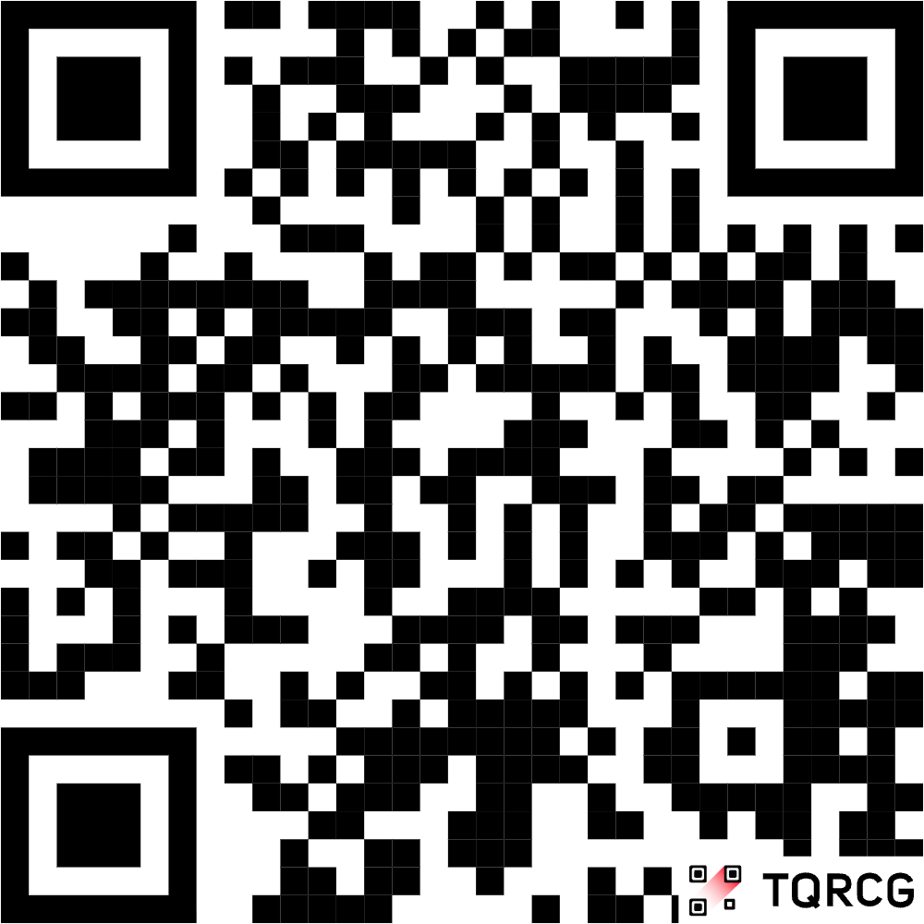

JOIN THE WAITLIST
FOLLOW US
WE ARE LIVE
FOUNDING TEAM
@techies_hub_frU
BALAJI FOUNDER
SHREYAS CO-FOUNDER
TEJAS CTO
www.sak-d89.pages.dev

Slide 11
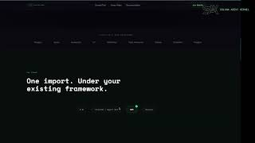

Slide 12
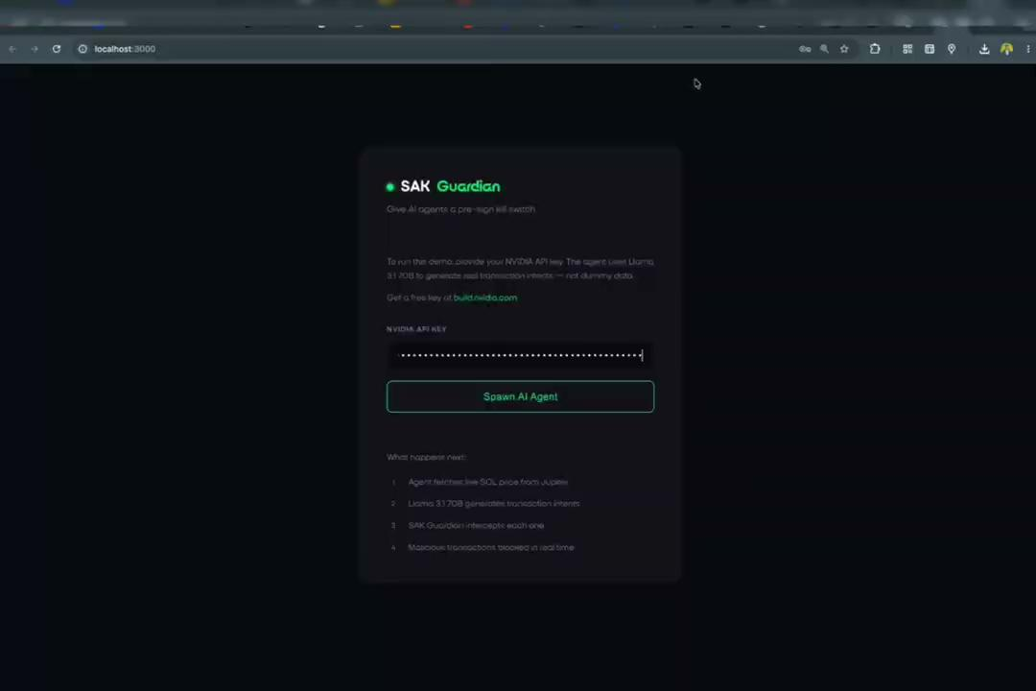

Slide 13


COMPETITIVE DIFFERENTIATION
FEATURE | PHANTOM | HYPERNATIVE | SAK
Pre-Sign Simulation | ✅ (Human) | ✅ (Wallet API) | ✅ (Autonomous SDK)
Autonomous Rule Engine | ❌ | ❌ | ✅ (Deterministic)
Same-Slot Awareness | ❌ | ✅ | ✅ (Geyser Push)
ZK Compressed State | ❌ | ❌ | ✅ (1000x cheaper)
Target User | Humans | Custodians | AI Agent Devs

